Slide 1

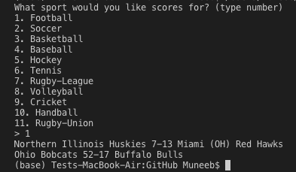
Sports Savvy Coders: Ryan Wood, Muneeb Syed Contributor: Evan Sloan
Sports Statistics: Allows user to scrape sports statistics off various websites at one time. The sports will include football, baseball, basketball, hockey, etc.

